Slide 1
Stephanie Hales
Portfolio

Slide 2


Slide 3



Slide 4
Overview
Professional Portfolio
Provide insight for prospective employers
Minimalist design
Simple navigation
Key components built for context and design

Slide 5
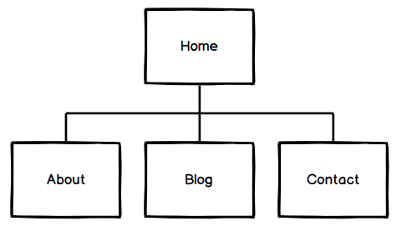
Sitemap

Slide 6
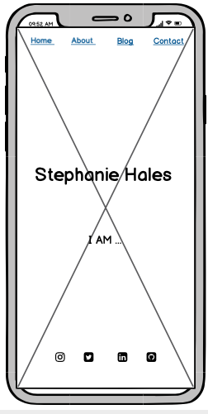
Wireframes
Notes:
Mobile first design

Slide 7
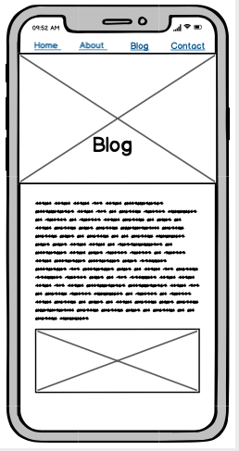
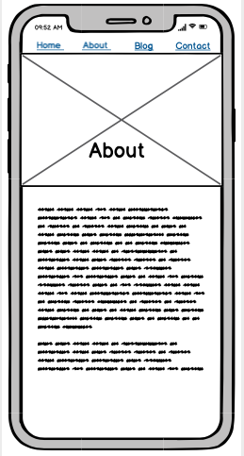
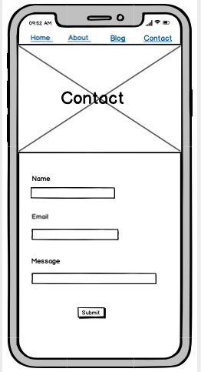

Slide 8
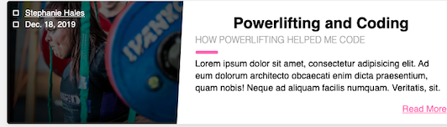
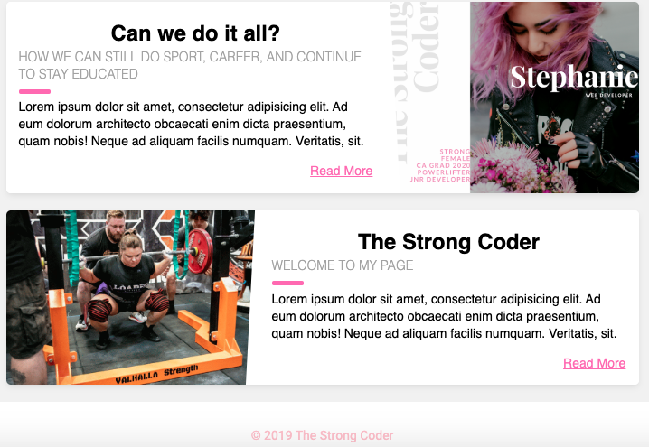
Components
Changing words
Scroll Container
Navigation bar
Barbell Animation
Blog cards
Contact form

Slide 9
